Slide 1

DBSCAN Clustering
==========================================================================================================

Slide 2
What is DBSCAN Clustering Algorithm?
DBSCAN--- Density Based Spatial Clustering of Applications with Noise
DBSCAN is a density-based clustering method used in machine learning to separate clusters of high density from clusters of low density.
==========================================================================================================

Slide 3
DBSCAN Clustering
▪ A dense cluster is a region in which the density of points is greater than a minimum.
▪ Since DBSCAN algorithm expand clusters based on density, they form clusters of arbitrary shapes.
==========================================================================================================

Slide 4
DBSCAN Clustering: Core, Border, Noise points
A Core point has more than a certain number of points (MinPts) within Eps.Core points are at the interior of a cluster
A border point has fewer than MinPts within Eps, but
is in the neighborhood of a core point
A noise point is any point that is neither a core point nor a border point
==========================================================================================================

Slide 5
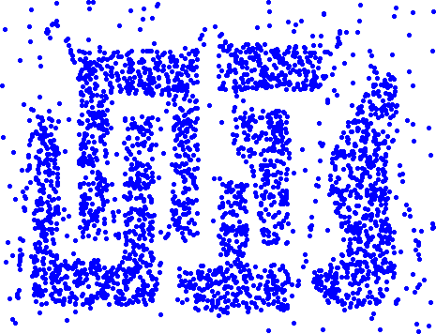
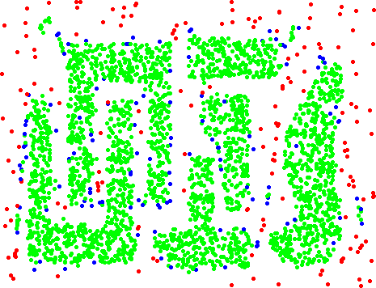
DBSCAN Clustering: Core, Border, Noise points
Original Points
Point types: core, border and noise
==========================================================================================================

Slide 6
DBSCAN Clustering: Process
Any two core points close enough– within a distance Eps of one another – are put in the same cluster
Any border point that is close enough to a core point is put in the same cluster as the core point
Noise points are discarded
==========================================================================================================

Slide 7
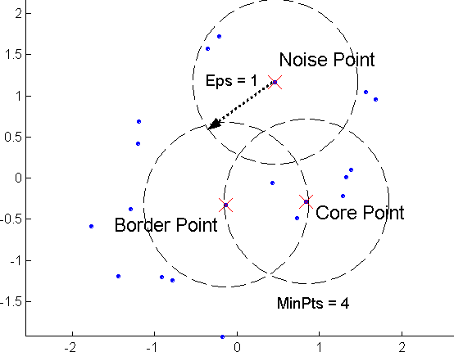
DBSCAN Clustering: Core, Border, Noise points
==========================================================================================================

Slide 8
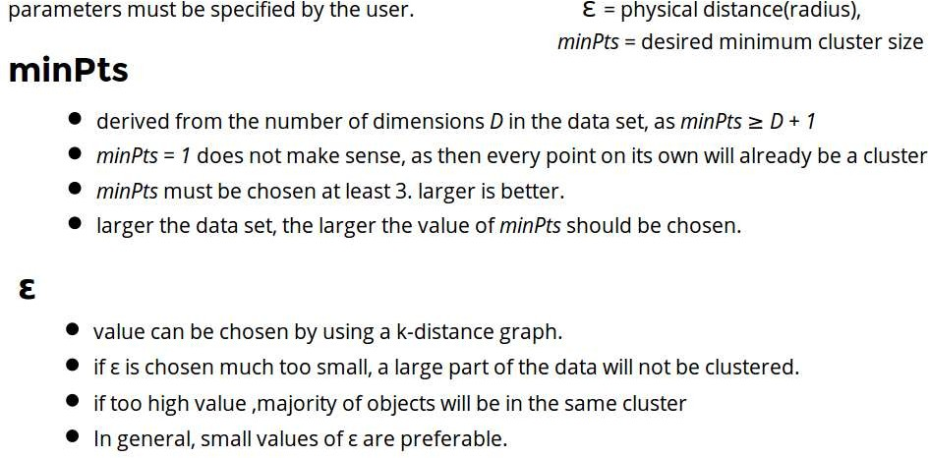
Parameter Estimation
==========================================================================================================

Slide 9






Concepts: ε-Neighborhood
ε-Neighborhood - Objects within a radius of ε from an object. (epsilon-neighborhood)
Core objects - ε-Neighborhood of an object contains at least MinPts of objects
ε-Neighborhood of p
ε-Neighborhood of q
p is a core object (MinPts = 4)
q is not a core object
ε
ε
p
q
==========================================================================================================

Slide 10
DBSCAN : Reachability
Directly density-reachable
– An object q is directly density-reachable from object p if q is within the ε-Neighborhood of p and p is a core object.
q is directly density- reachable from p
p is not directly density- reachable from q.
ε
ε
p
q
==========================================================================================================

Slide 11
DBSCAN : Reachability
q
p
==========================================================================================================

Slide 12





DBSCAN :Connectivity
Density-connectivity
– Object p is density-connected to object q w.r.t ε and MinPts if there is an object r such that both p and q are density-reachable from r w.r.t ε and MinPts
P and q are density- connected to each other by r
Density-connectivity is symmetric
q
r
p
==========================================================================================================

Slide 13
Core, Border, Noise points representation
Point types: core, border and noise
Eps = 10, MinPts = 4
Original Points
==========================================================================================================

Slide 14
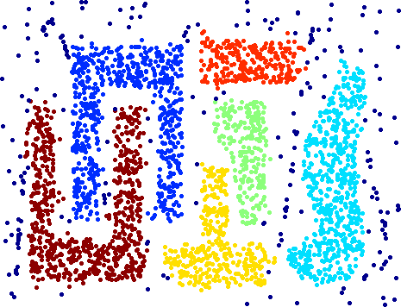
DBSCAN Clustering
Original Points
Clusters
Resistant to Noise
Can handle clusters of different shapes and sizes
==========================================================================================================

Slide 15
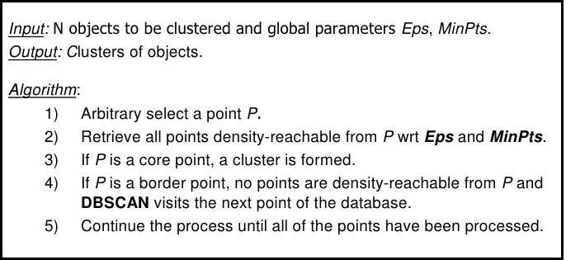
DBScan Algorithm
==========================================================================================================

Slide 16
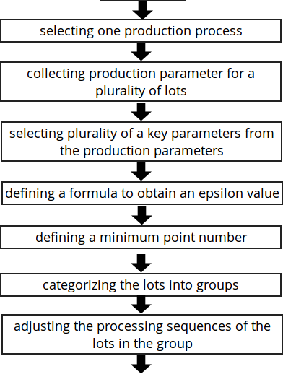
DBScan :Flowchart
Start
End
==========================================================================================================

Slide 17
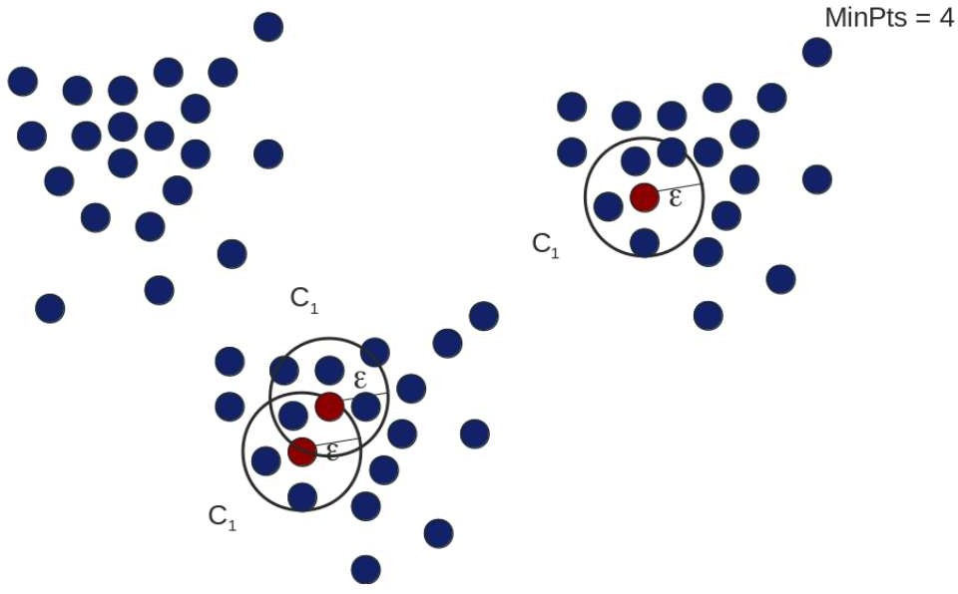
DBScan : Example
==========================================================================================================

Slide 18
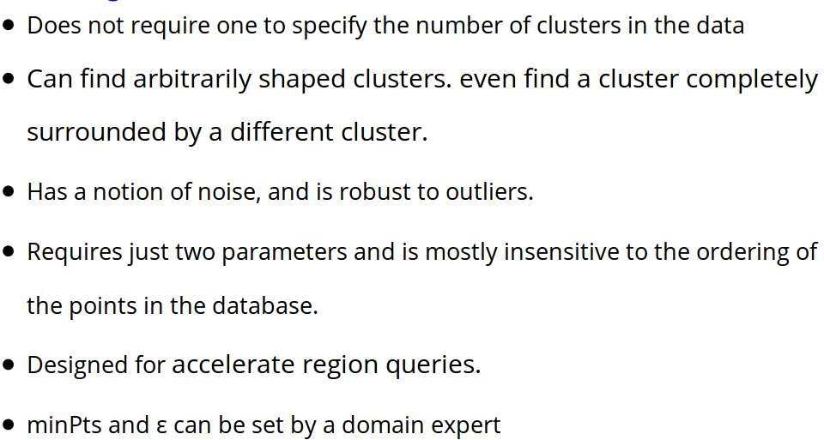
DBSCAN : Advantages
==========================================================================================================

Slide 19
DBSCAN : Disadvantages
DBSCAN is not entirely deterministic: Border points
that are reachable from more than one cluster can be part of either cluster, depending on the order the data is processed.
The quality of DBSCAN depends on the distance measure used in the function regionQuery. (such as Euclidean distance)
If the data and scale are not well understood, choosing a meaningful distance threshold ε can be difficult.
==========================================================================================================

Slide 20
DBSCAN : Complexity
Time Complexity: O(n²)
for each point it has to be determined if it is a core point.
can be reduced to O(n*log(n)) in lower dimensional spaces by using efficient data structures (n is the number of objects to be clustered);
Space Complexity: O(n).
==========================================================================================================

Slide 21
Summary of DBSCAN
Advantages:
can detect arbitrary shapes
not very sensitive to noise
supports outlier detection
complexity is kind of okay
the second most used clustering algorithm after K-means
==========================================================================================================

Slide 22
Summary of DBSCAN
Disadvantages:
does not work well in high-dimensional datasets
parameter selection is tricky
has problems of identifying clusters of varying densities (SSN algorithm)
density estimation is kind of simplistic (does not create a real density function, but rather a graph of density-connected points)
==========================================================================================================

